Slide 1
Online Edu. Employment (Android)
Design Workshop
VEL team
21 Aug. 2015

Slide 2
Project Plan
Agenda
1. xxx
2. xxx
3. xxx
4. xxx
5. xxx
6. Admin Module
7. xxx
8. xxx

Slide 3
%%. Design Decisions
Non-Functional Requirements
Mobile-friendly | Google Search will be expanding its use of mobile-friendliness as a ranking signal. (as cited form https://support.google.com/adsense/answer/6196932?hl) Current GetSkills.co.nz website through “Google mobile-friendly test tool”, Links too close together. Text too small to read Mobile viewport not set Content wider than screen
Security | Getskills.co.nz – online education/employment training website. contains confidential business the website needs strictly security and protect privacy.
Maintainability | Getskills.co.nz website contains four modules – students, employer company, teachers and administrator. We decide the maintainable attributes in refined Getskills.co.nz websites will keep pace with the exist website.
Aesthetic property | CEO : “industry need artists and designers to help connect our business with end customers and establish a trust in the brand.” Our team decide to re-beautify the current web pages. improve the current website page designs to make it more appealing. Relevant techniques involve: CSS, JavaScript.

Slide 4
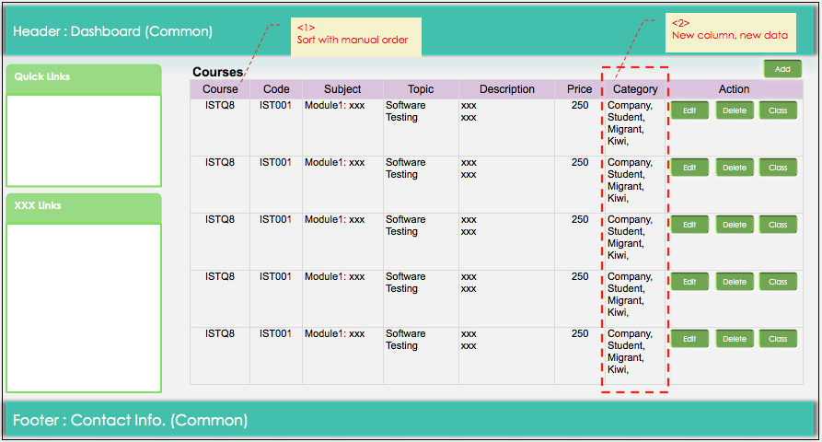
6. Admin Module (1)
Admin Module: Courses

Slide 5
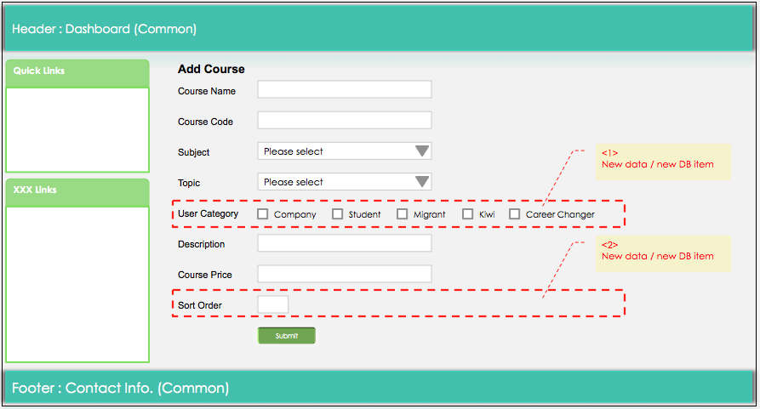
6. Admin Module (2)
Admin Module: Courses

Slide 6
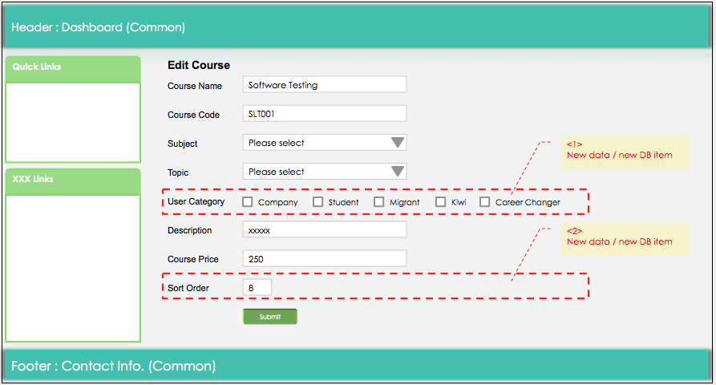
6. Admin Module (3)
Admin Module: Courses

Slide 7
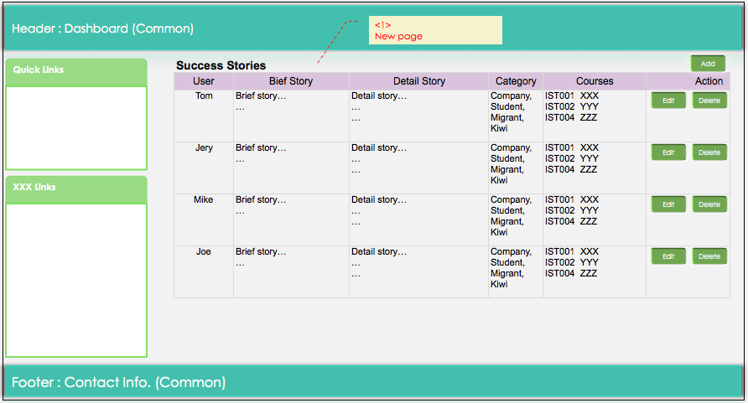
6. Admin Module (4)
Admin Module: Success Stories

Slide 8
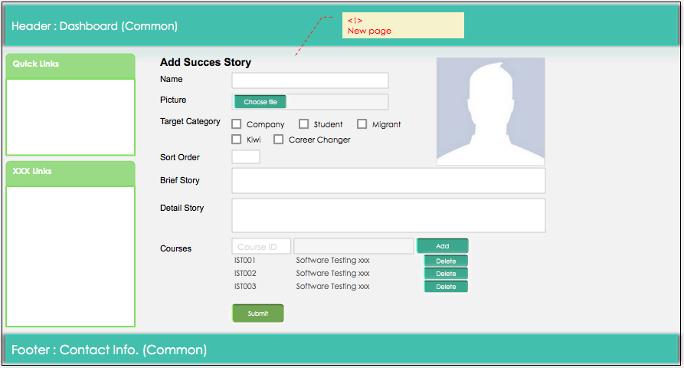
6. Admin Module (5)
Admin Module: Success Stories

Slide 9
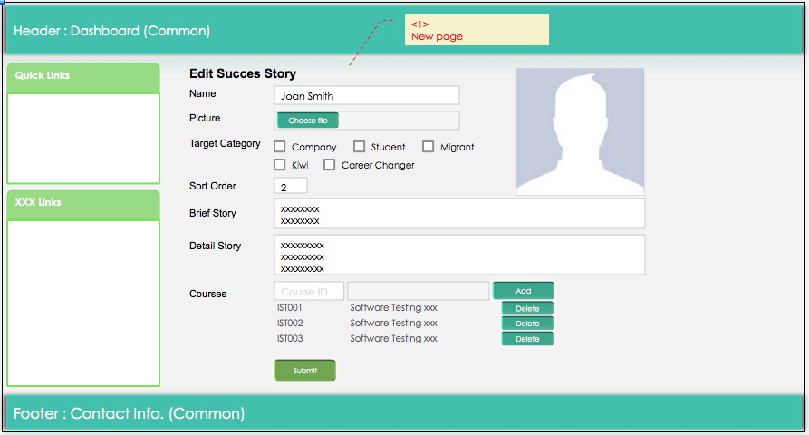
6. Admin Module (6)
Admin Module: Success Stories

